Slide 1
Introduction to the brain and drugs
.

Slide 2
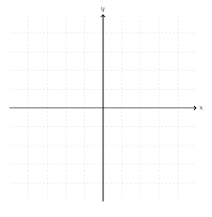

Slide 3
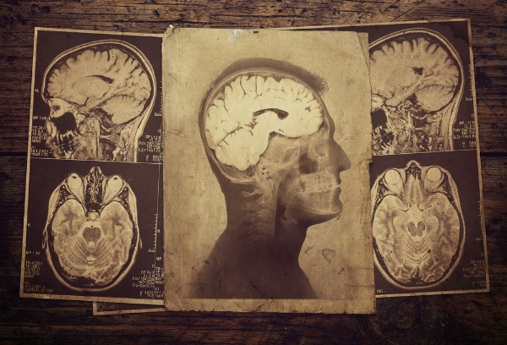
The Brain
Do you believe in miracles?

Slide 4
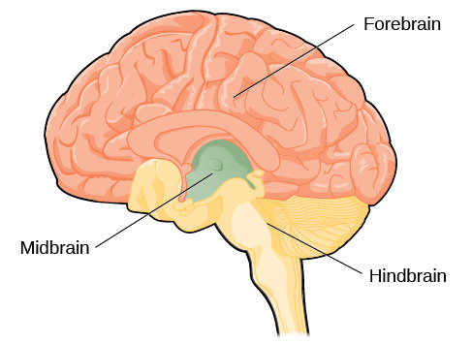
the brain
Essence of who we are created by the brain.
The brain has three parts: forebrain, midbrain, and hindbrain.

Slide 5
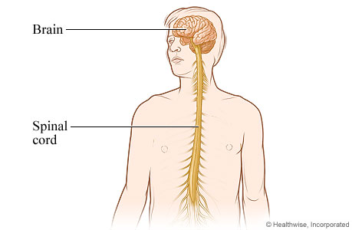
The CNS
CNS divided into the brain and the spinal cord.
They are protected by bones.

Slide 6
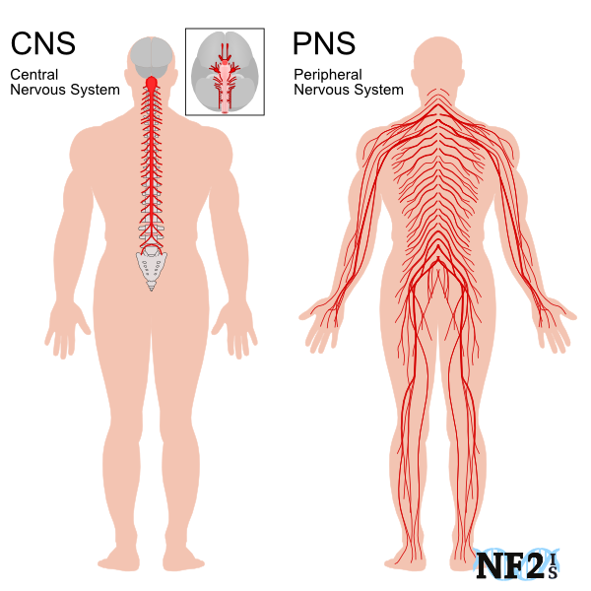
PNS
PNS divided into
SomaticNS
AutonomicNS.
.

Slide 7
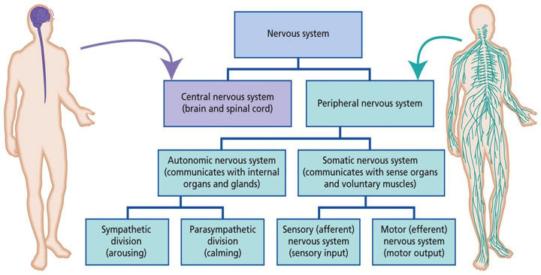
Nervous system Layout

Slide 8
Limbic System
The limbic system is known as ‘the emotional brain’.
Responsible for experiencing emotion, behaviour, motivation, long-term memory, learning, and monitoring internal homeostasis of body.

Slide 9

Five stages of Sleep
Stages one and two: initial stages of sleep. Stage one counts for approximately 5% of our time asleep. Stage two counts for 40-50%.
Stages three and four: deeper stages of sleep
Stage five: rapid eye movement (REM) stage and counts for 20-25% of our time asleep.

Slide 10
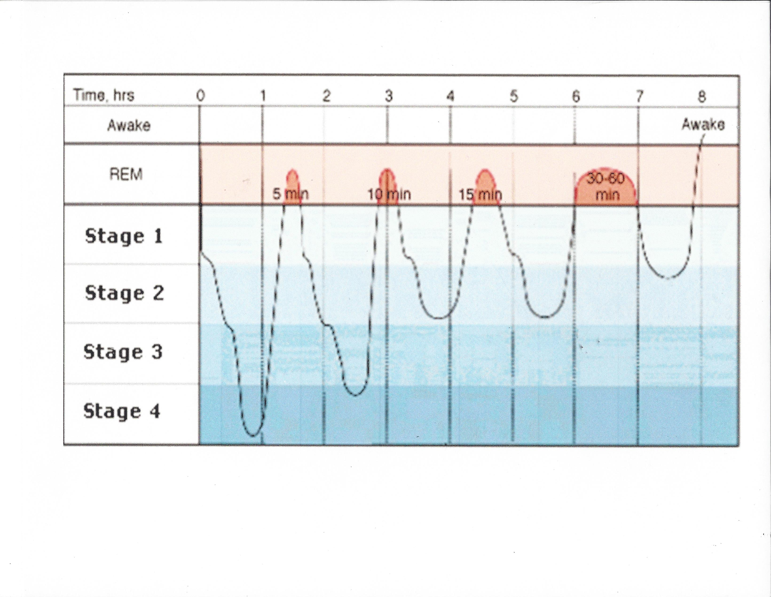

Slide 11
Sleep CYCLE: Stage five – REM Sleep
REM is the dreaming stage where the mind replays both good and traumatic events, and events that haven’t happened.
Muscles are relaxed, but person can experience sensation of moving while dreaming.
Eye movements thought to be the person scanning their environment in their dream. REM cycle happens about 90 minutes after a person has entered stage one of sleep.
REM related to memory retention and consolidation- memory retention is dampened when REM sleep decreased or non-existent
REM thought to remove information that is not needed

Slide 12
Psychoactive drug Groups
.

Slide 13
How are Psychoactive Drugs Categorized?
By their effects on the central nervous system (CNS).
Four categories:
Depressants (including Opioids),
Stimulants,
Hallucinogens and,
Psychotherapeutic Agents

Slide 14
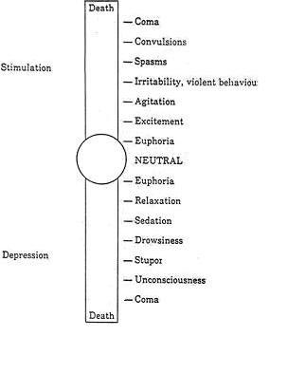

Slide 15
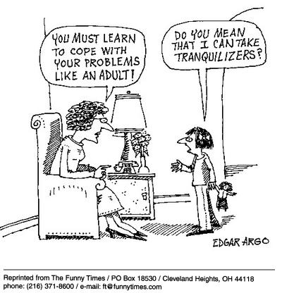
Depressants
Therapeutic uses: sedation, reducing anxiety, enhancing sleep.
Enhance mood by the drug’s disinhibiting properties.

Slide 16
Depressants
Barbiturates
Non-barbiturate sedative-hypnotics (NBSH)
Benzodiazepines
Inhalants (including solvents, aerosols, and anesthetics)
Antihistamines
Alcohol

Slide 17
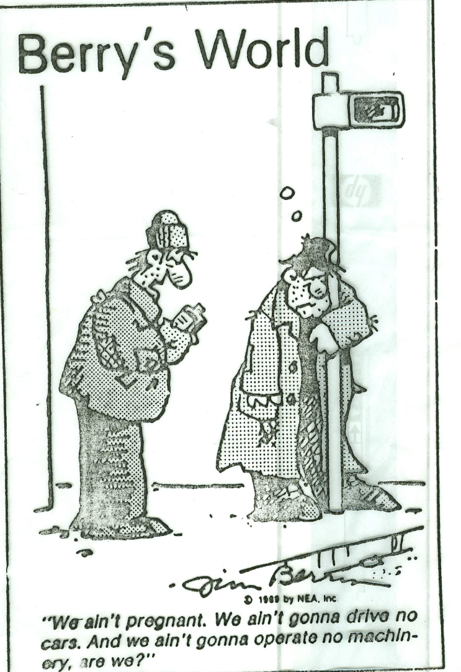
ALCOHOL

Slide 18
Opioids
Depressants primarily effect the neurotransmitter gamma-aminobutyric acid (GABA).
But opioids are a subgroup of CNS depressants that effect endorphins.

Slide 19
Opioids
Natural
Morphine Codeine
Semi-Synthetic
Heroin Dilaudid Oxycodone
Synthetic
Demerol Methadone

Slide 20
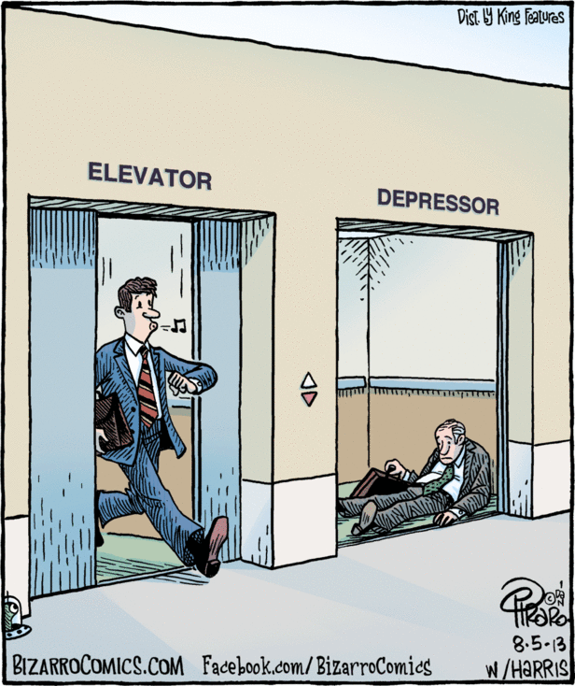
Myth
Depressants do not necessarily depress a person’s mood, but they can slow down brain activity.

Slide 21
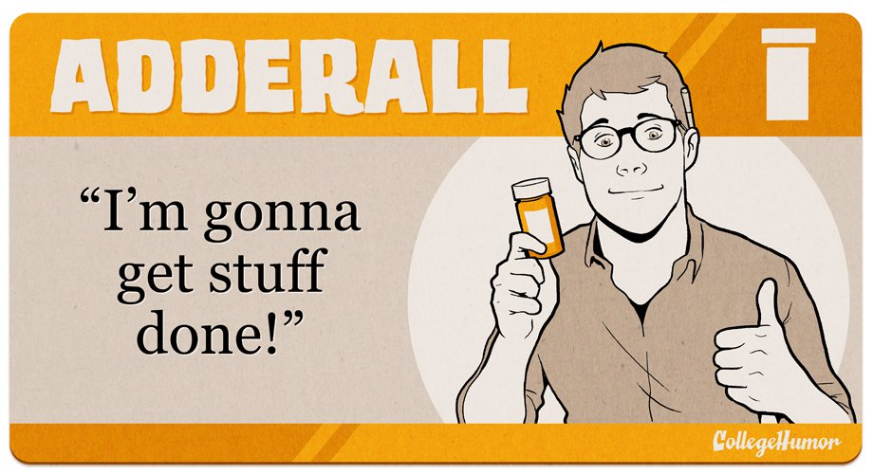
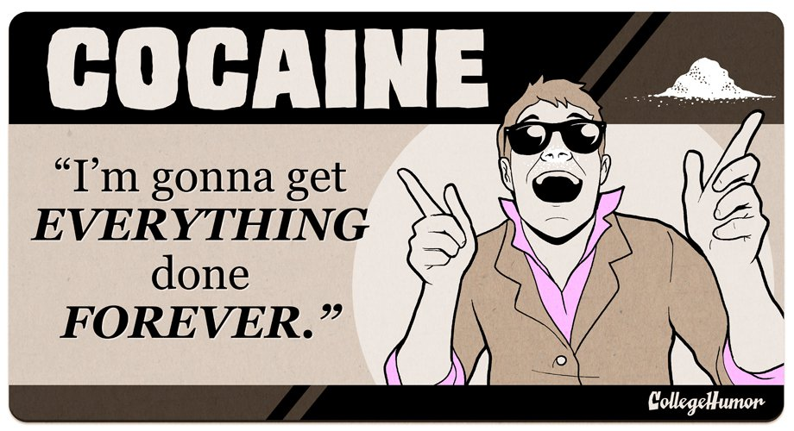
Stimulants
Therapeutic uses: as decongestants, supressing appetite, treating attention-deficit/hyperactivity disorder (ADHD).

Slide 22
Stimulants
Cocaine Ritalin, Anorexiants, Decongestants, Khat Bath salts | Amphetamines (including methamphetamine), Betel, Nicotine and, Caffeine

Slide 23
Hallucinogens
Disrupts way brain perceives stimuli instead of decreasing or increasing CNS activity to produce euphoria.

Slide 24
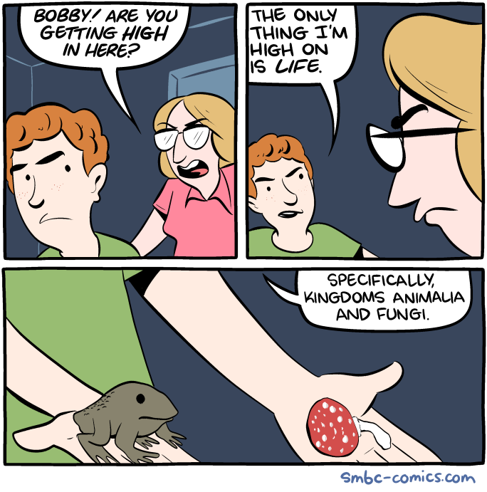
Hallucinogens
Creates disconnect between physical world and user’s perception of physical world.
Four groups of hallucinogens.

Slide 25
Hallucinogen groups
Group: | Indolealkylamines | Phenylethylamines | Dissociative anaesthetics | Cannabis
Types: | LSD, Psilocybin | Mescaline, ecstasy, jimson weed | PCP, ketamine | Cannabis
Effects: | No secondary psychoactive effects | Structurally similar to amphetamines, produce secondary stimulant effects on body | Possess depressant properties along with their hallucinatory effects and are members of the arylcycloalkylamine family | Affects distinct neurotransmitter from other hallucinogens: endocannabinoid. Only hallucinogen to create physical dependency and fully addicting substance.

Slide 26
Psychotherapeutic Agents
Primarily used to treat people with specific forms of mental health issues.

Slide 27
Three categories
Antidepressants
Antipsychotics
Mood Stabilizers

